Slide 1

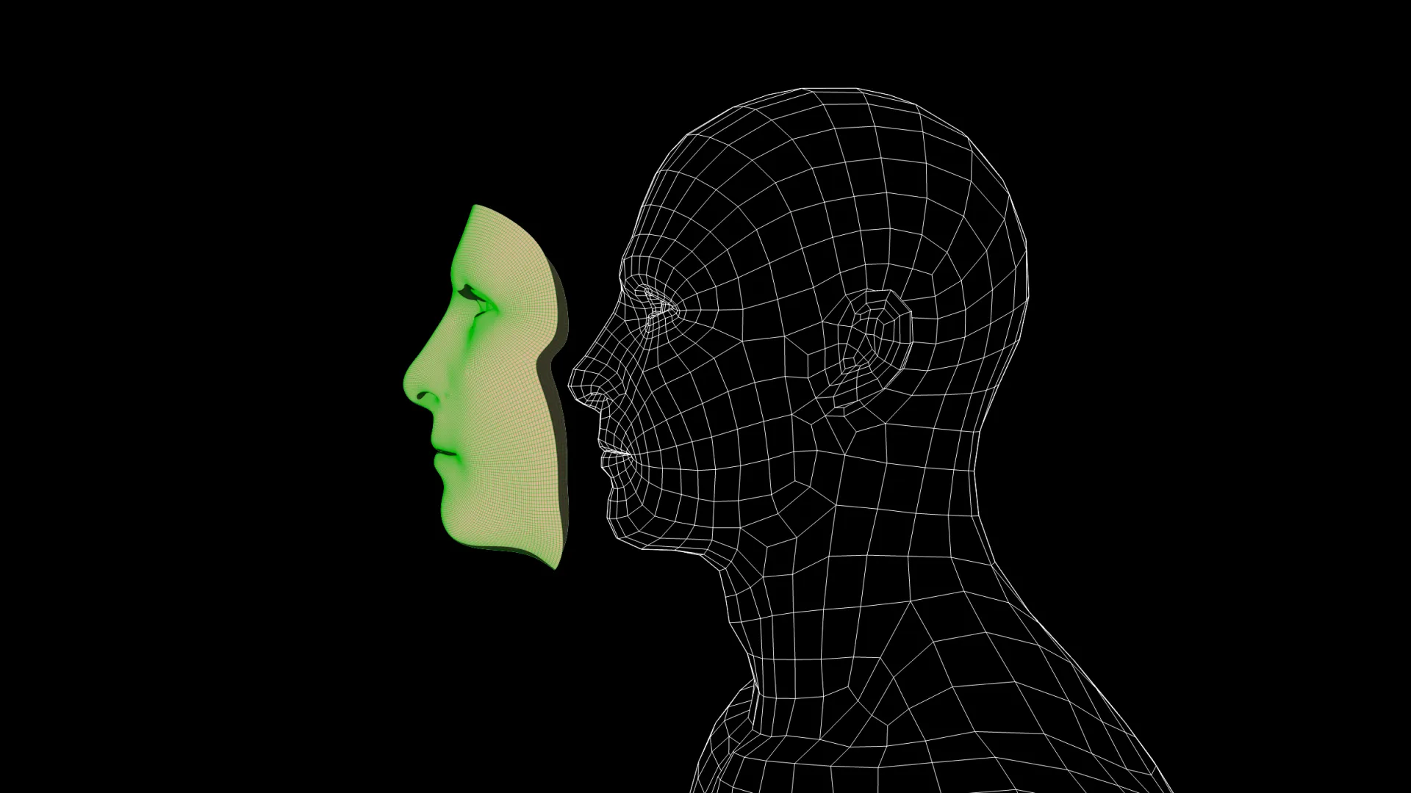
Deepfake Detection model for image
Instructor: Dr. Wojdan BinSaeedan
Prepared by:
Alhanouf Almansour (440019183) Raghad Albosais (440020209)
Khloud Alnufaie (440020617) Weaam Alghaith (440023306)
Section: 371

Slide 2
content
Dataset overview
Discussion
Analyze the results
Video Screen
Introduction
Dataset
Step of implementaion
Result
Tools and technologies
Demo
Conclusion
Problem statement
Problem formulation
Model architecture
Preparing the data
Model development
Model evaluation
Model improvement
Model prediction/inference
Model deployment
Implemention
Documntation
Design tool
summery

Slide 3
Introduction
Problem statement
Deepfake is a newly emerged issue in our modern days.
The content of an image can shake the world either because it sparks controversy, or discredits someone. An individual may be accused or suspected of a situation that did not actually occur.
For example, change person expression to sad when in reality, they are happy.
Problem formulation
Task (T): Classify an image to a real or a fake depend on that has manipulated or not.
Experience (E): A corpus of images for exist person or not exist.
Performance (P): Classification precision, the number of image predicted correctly true positives (TP) over the number of true positives plus the number image predicted incorrectly of false negatives (FN).

Slide 4
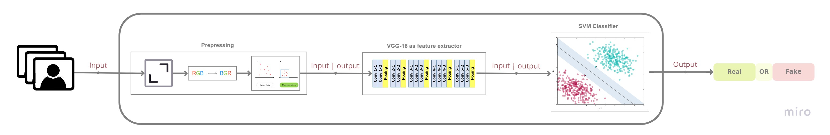
Model architecture

Slide 5
DATASET

Slide 6
“Real and Fake Face Detection” challenge dataset of Kaggle.
Dataset: https: https://www.kaggle.com/datasets/ciplab/real-and-fake-face-detection

Slide 7

Step of implmentaion
Let’s descripe

Slide 8
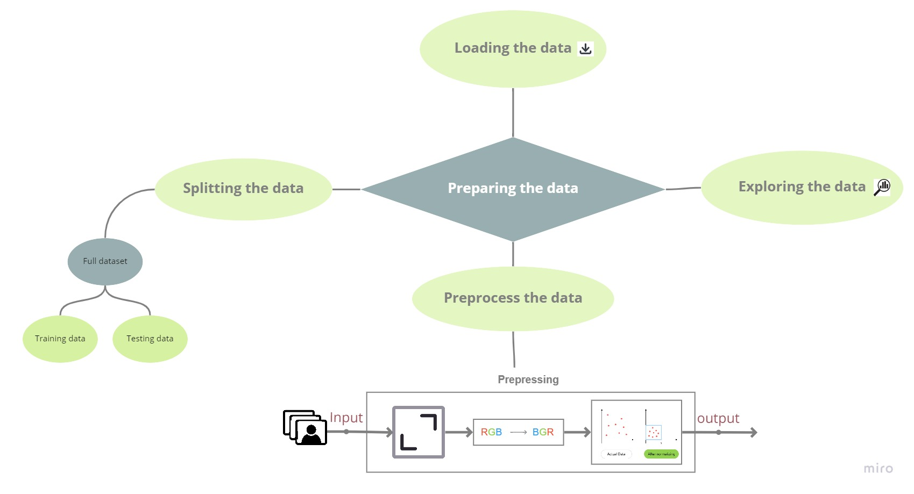
Preparing the data

Slide 9
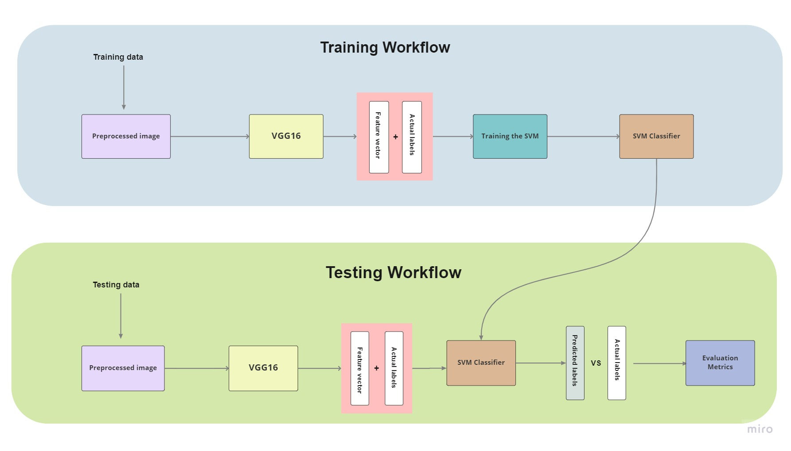
Model development & evaluation

Slide 10
Model improvement
Using GridSearchCV() with training data, to Finding the hyperparameter value of a SVM to produce best SVM model.
{ }
Hyperparameter
Best Score: 0.669
Best parameters set: {'C': 10, 'gamma': 0.0001, 'kernel': 'rbf’}
Best model: SVC(C=10, gamma=0.0001)
'C': [1, 10, 100, 1000],
'kernel': ['linear’], ['rbf']},
'gamma': [1, 0.1, 0.01, 0.001, 0.0001
GridSearch

Slide 11
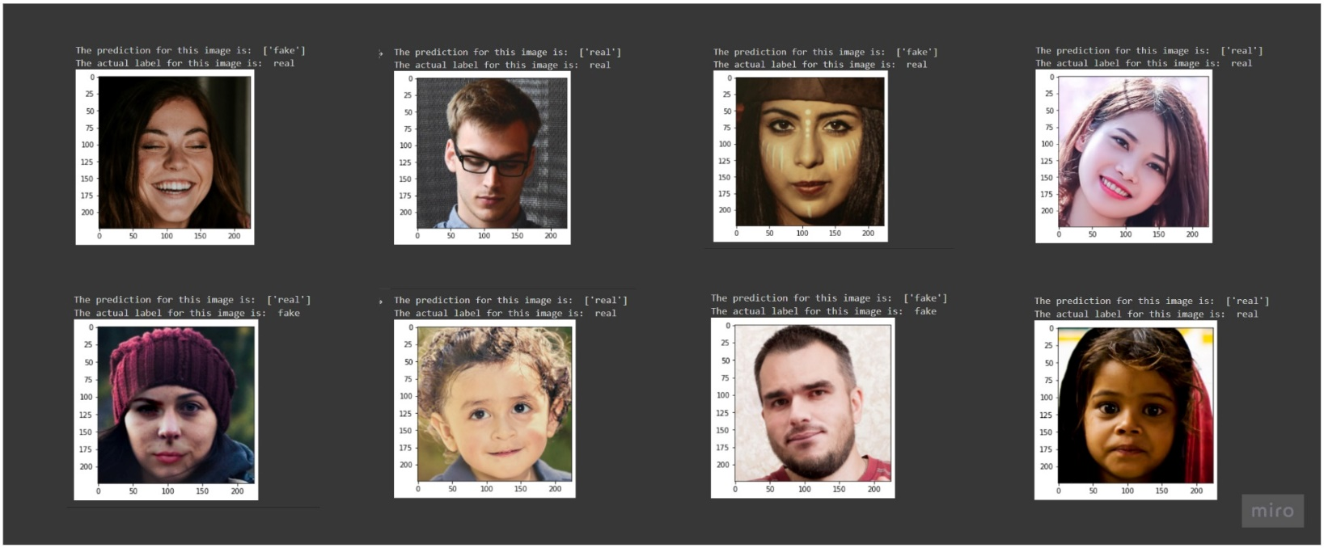
Model prediction/inference

Slide 12
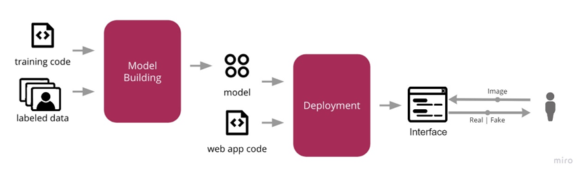
Model deployment

Slide 13
RESULTS

Slide 14
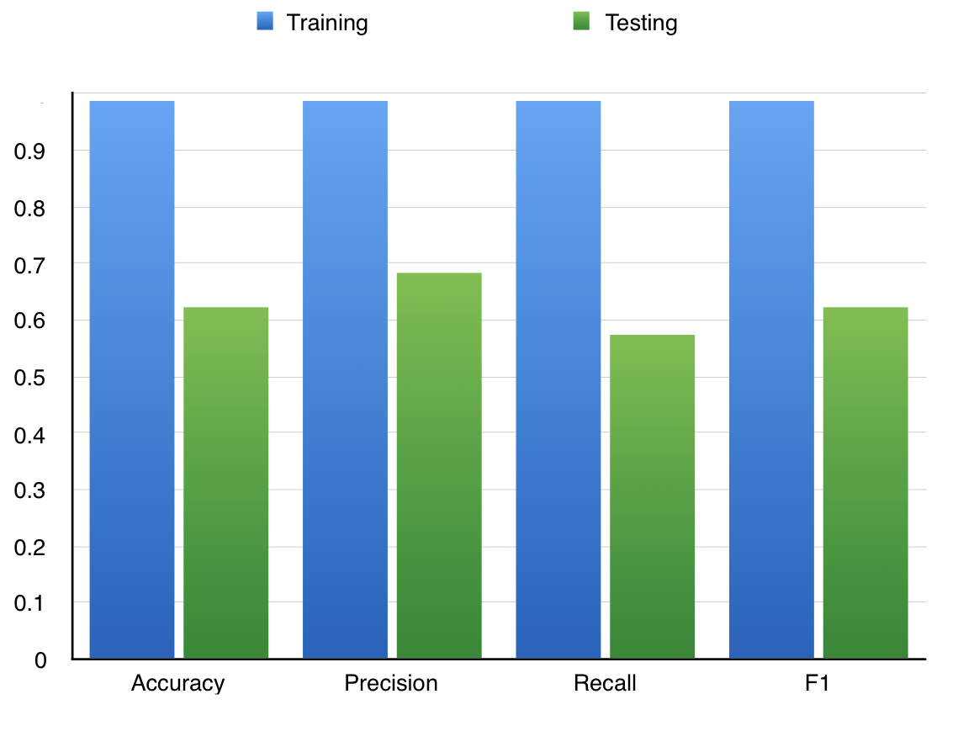
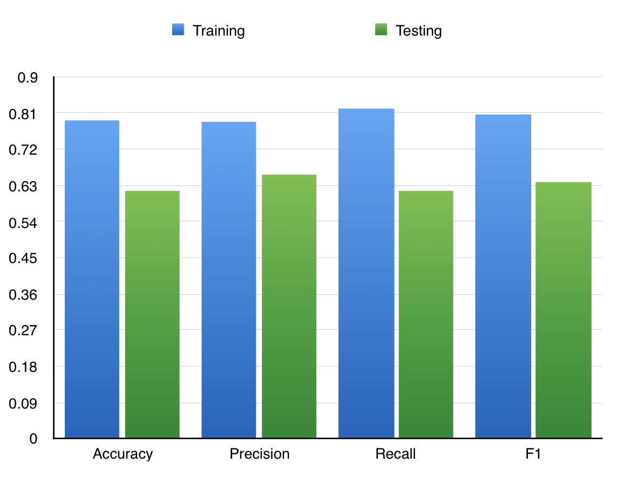
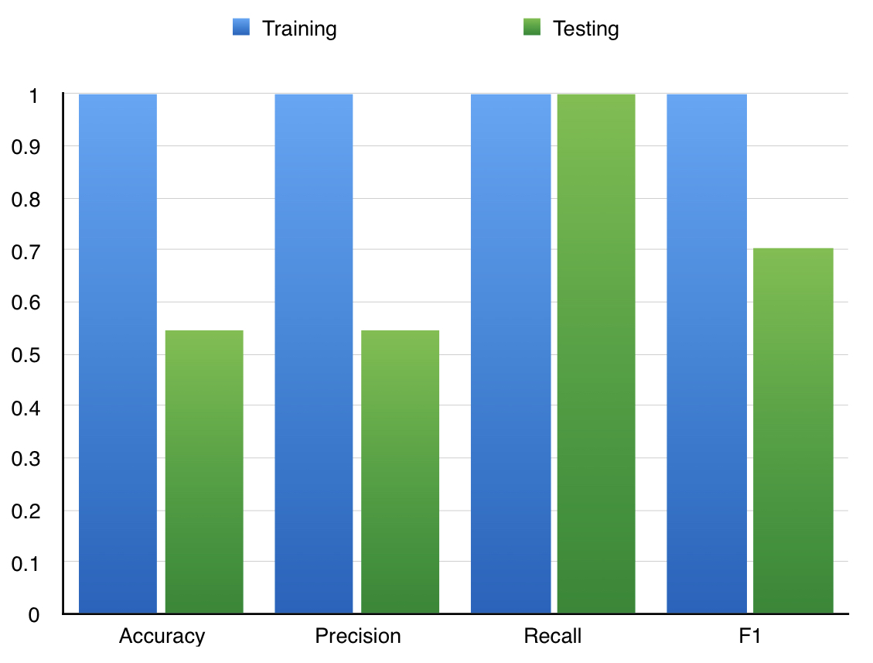
Discussion Analyze the results
Default (no parameter)
Precision hyper parameter
F1 hyper parameter

Slide 15
Tools and technologies

Slide 16
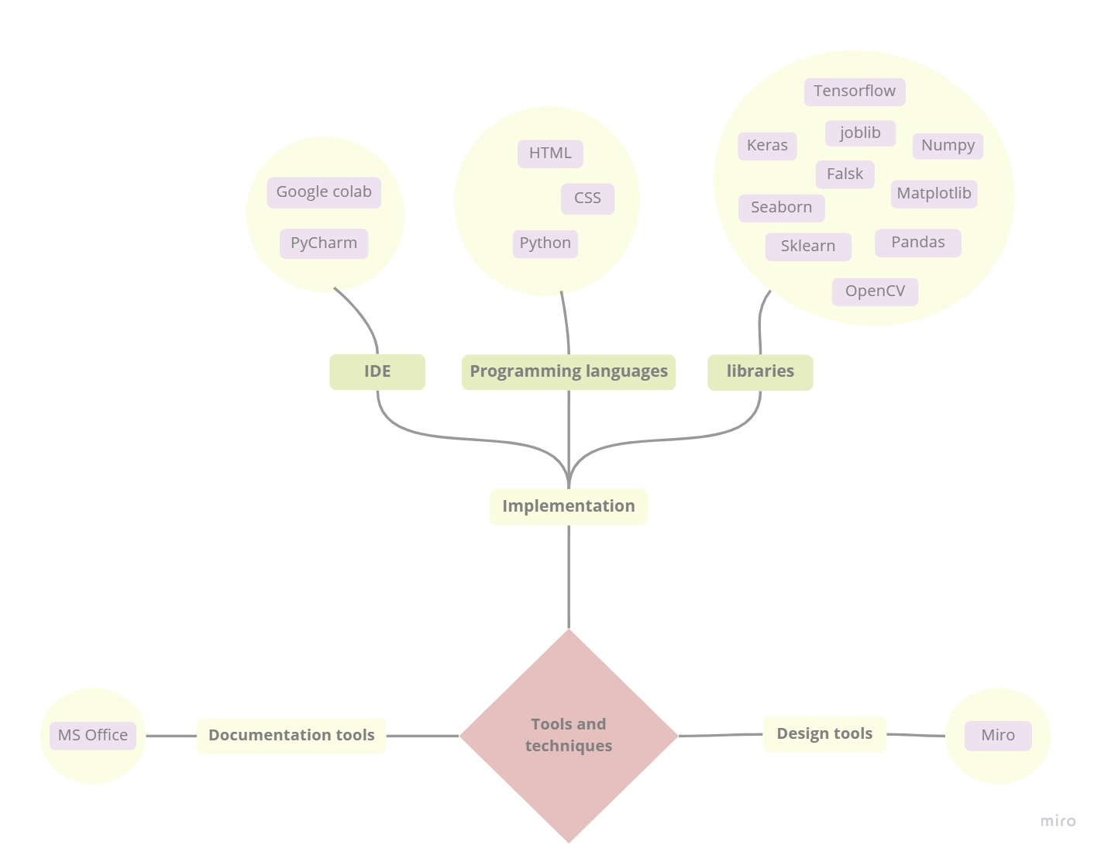

Slide 17


Demo

Slide 18
Conclusion
We have achieved a high-precision deepfake detector using transfer learning where the pretrained CNN (VGG16) as feature extractor and SVM is trained using the features .

Slide 19
Thanks!
Any questions?

